Slide 1
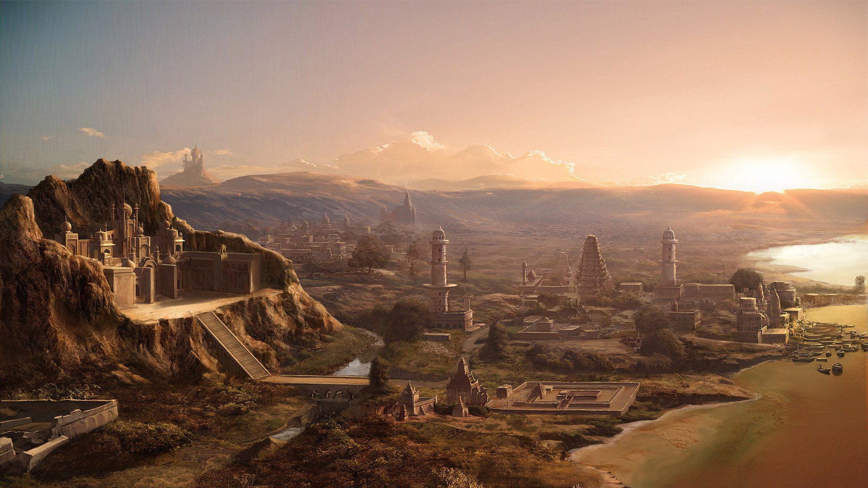
Ancient Civilizations
Whose civilization will grow the largest?

Slide 2
Create Your Own Civilization
Your map must include the following:
Your name
The name of your civilization in big letters
The physical features you choose in Section 1
Symbols to show what resources your civilization has from Sections 2, 3 and 4.
Color – be creative!

Slide 3

Year One
During the first year of your civilization, your population grew in size thanks to your food choices. The world also experienced some random events, as it does every year. Fortunately, you did not encounter any other civilizations… yet.

Slide 4
Year One – Food Bonuses
Your population grows based on how much food is available to feed your citizens. Some types of food are more efficient than others. Use the values shown to determine how much your civilization grows from food this year.
Beans +10 citizens
Chickens +10 citizens
Corn +15 citizens
Cows +20 citizens
Fish +10 citizens
Oranges +5 citizens
Potatoes +15 citizens
Wheat +20 citizens

Slide 5
Year One – The Plague
In the very first year of your civilization, a terrible disease struck many your animals. This disease spread to your human population as well, creating a devastating plague.
If you have cats, chickens, cows, dogs or horses, you have lost 50 citizens.

Slide 6
Year One – Random Events
As always, random events happen to the world. These could be natural disasters, new technology discoveries, or even unexplained circumstances.
This year, we will draw five random event cards.

Slide 7
Year Two
During the second year of your civilization, your population grew in size thanks to your food choices. The world also experienced some random events, as it does every year. You also encountered a neighboring civilization and decided to trade peacefully.

Slide 8
Year Two – Food Bonuses
Your population grows based on how much food is available to feed your citizens. Some types of food are more efficient than others. Use the values shown to determine how much your civilization grows from food this year.
Beans +10 citizens
Chickens +10 citizens
Corn +15 citizens
Cows +20 citizens
Fish +10 citizens
Oranges +5 citizens
Potatoes +15 citizens
Wheat +20 citizens

Slide 9
Year Two – Trade!
One day while wandering near the border of your civilization, you encounter people you do not recognize. After a formal greeting, you share one of your resources in exchange for one of the resources from this newly-discovered civilization.
Both civilizations must agree on what is traded.

Slide 10
Year Two – Random Events
As always, random events happen to the world. These could be natural disasters, new technology discoveries, or even unexplained circumstances.
This year, we will draw ten random event cards.

Slide 11
Year Three
During the third year of your civilization, your population grew in size thanks to your food choices. The world also experienced some random events, as it does every year. You also encountered a neighboring civilization and decided to make war!

Slide 12
Year Three – Food Bonuses
Your population grows based on how much food is available to feed your citizens. Some types of food are more efficient than others. Use the values shown to determine how much your civilization grows from food this year.
Beans +10 citizens
Chickens +10 citizens
Corn +15 citizens
Cows +20 citizens
Fish +10 citizens
Oranges +5 citizens
Potatoes +15 citizens
Wheat +20 citizens

Slide 13
Year Three – War!
One day while wandering near the border of your civilization, you encounter people you do not recognize. For reasons no one will ever understand, you decide to fight.
You send half of your citizens to war. After a long, bloody series of battles, they are all dead, except…

Slide 14
Year Three – War!
Bronze +10 citizens
Camels +5 citizens
Desert +5 citizens
Horses +10 citizens
Iron +15 citizens
Island +15 citizens
Mountains +15 citizens
Ocean +10 citizens
Pine trees +5 citizens
Rainforest +5 citizens
River +5 citizens
Stone +5 citizens
Horses and iron, stone or bronze +20 citizens
To calculate your losses, take half of your population, subtract your war bonuses from the right, and then subtract this total from your current population.
For example, if I have 100 citizens and I have an ocean civilization with horses, I send 50 citizens to war and my war bonus is 10+10=20, so I lose 50-20=30 citizens and my new population is 70 citizens.

Slide 15
Year Three – Random Events
As always, random events happen to the world. These could be natural disasters, new technology discoveries, or even unexplained circumstances.
This year, we will draw five random event cards.

Slide 16
Year Four
During the fourth year of your civilization, your population grew in size thanks to your food choices. The world also experienced some random events, as it does every year. You also encountered a neighboring civilization and, realizing the mistake you made last year, again decided to trade peacefully.

Slide 17
Year Four – Food Bonuses
Your population grows based on how much food is available to feed your citizens. Some types of food are more efficient than others. Use the values shown to determine how much your civilization grows from food this year.
Beans +10 citizens
Chickens +10 citizens
Corn +15 citizens
Cows +20 citizens
Fish +10 citizens
Oranges +5 citizens
Potatoes +15 citizens
Wheat +20 citizens

Slide 18
Year Four – Trade!
One day while wandering near the border of your civilization, you encounter people you do not recognize. After a formal greeting, you share one of your resources in exchange for one of the resources from this newly-discovered civilization.
Both civilizations must agree on what is traded.

Slide 19
Year Four – Random Events
As always, random events happen to the world. These could be natural disasters, new technology discoveries, or even unexplained circumstances.
This year, we will draw ten random event cards.

Slide 20
Year Five
During the fifth and final year of your civilization, your population grew in size thanks to your food choices. The world also experienced some random events, as it does every year. You also encountered a neighboring civilization and, forgetting the mistakes of your past, decided to make war!

Slide 21
Year Five – Food Bonuses
Your population grows based on how much food is available to feed your citizens. Some types of food are more efficient than others. Use the values shown to determine how much your civilization grows from food this year.
Beans +10 citizens
Chickens +10 citizens
Corn +15 citizens
Cows +20 citizens
Fish +10 citizens
Oranges +5 citizens
Potatoes +15 citizens
Wheat +20 citizens

Slide 22
Year Five – War!
One day while wandering near the border of your civilization, you encounter people you do not recognize. For reasons no one will ever understand, you decide to fight.
You send half of your citizens to war. After a long, bloody series of battles, they are all dead, except…

Slide 23
Year Five – War!
Bronze +10 citizens
Camels +5 citizens
Desert +5 citizens
Horses +10 citizens
Iron +15 citizens
Island +15 citizens
Mountains +15 citizens
Ocean +10 citizens
Pine trees +5 citizens
Rainforest +5 citizens
River +5 citizens
Stone +5 citizens
Horses and iron, stone or bronze +20 citizens
To calculate your losses, take half of your population, subtract your war bonuses from the right, and then subtract this total from your current population.
For example, if I have 100 citizens and I have an ocean civilization with horses, I send 50 citizens to war and my war bonus is 10+10=20, so I lose 50-20=30 citizens and my new population is 70 citizens.

Slide 24
Year Five – The Plague
After the war, civilizations that had not built up an immunity to animal diseases faced even tougher losses, after disease spread from your enemy to your own population.
If you did not suffer the plague in Year One, you have now lost 100 citizens, unless you are on an island or in the mountains.

Slide 25
Year Five – Random Events
As always, random events happen to the world. These could be natural disasters, new technology discoveries, or even unexplained circumstances.
This year, we will draw five random event cards.

Slide 26
Year Five – The End
After five years, it is time to tally up your final population. While this is not the end for your civilization (unless everyone has already died ☹), this is the end of the game.
What have we learned about civilizations? What would we do differently next time?

